Slide 1
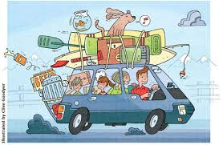


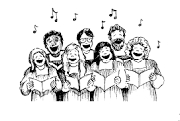
Moving beyond pitch and rhythm: the journey towards expressive musicality
Workshop outline
Introduction: why is this important
Basic principles: tools to guide score interpretation
Case studies: let’s apply these to real music

Slide 2
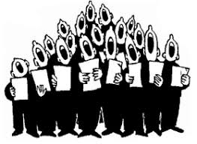

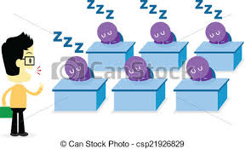

Introduction
On performance day…
  …“we finally got the notes, just in time!”
  …every piece sounds like every other piece, just different words and music
Accurate pitch and accurate rhythm…
  …are extremely important
    Poor pitch & sloppy/inaccurate rhythm can destroy any good choral work
  But…these are just the start
Question today: how we do go beyond P & R…
  …to help make our performances compelling?

Slide 3

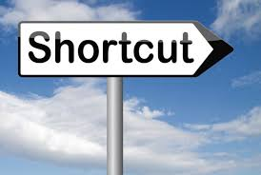
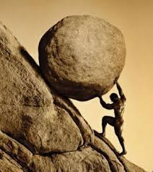
Introduction continued
Whose job?
  It is our job, the conductor!
  No short cut…
    …to careful score study and understanding
  WE have to do the work
  Our choirs will rise only to the level that we push
What is that work?
  Discover the expressive elements
  Help our choirs sing those elements

Slide 4



Will not talk about…
Facial expression
Memory or not memory
Choreography/dance

Slide 5

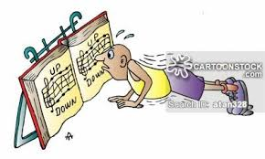
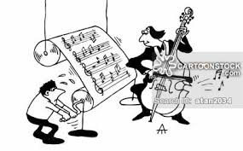
We will talk about…
Melody
Harmony
Rhythm
Dynamics
Text
Balance
Color
Style

Slide 6



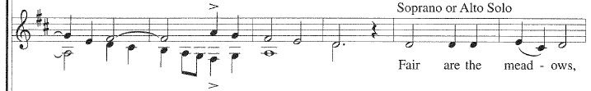
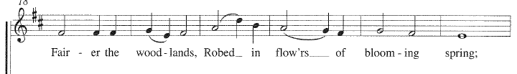

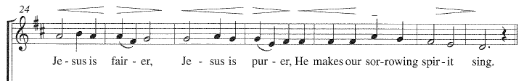
Basic principles: melody
Phrase structure?
Where is/are peak(s)?
How to shape these phrases, make them musical?
Notes:
Discussion: how to enhance? Gradual dynamic shaping, every single note

Slide 7
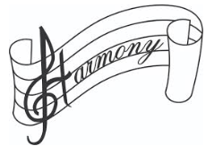
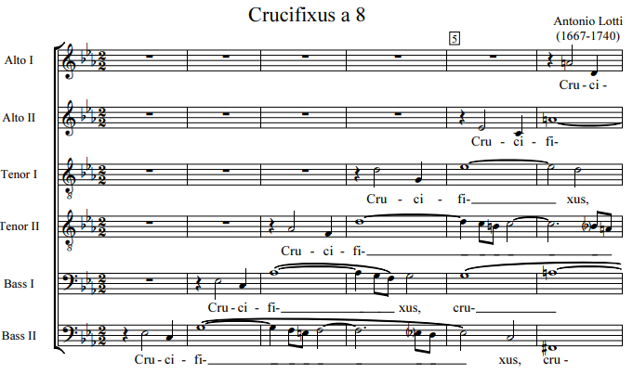

Harmony
Dissonance…
  pushes music forward
Consonance…
  lets music relax
Notes:
Discussion: how to enhance this? Volume, color, intensity of tone, NO vibrato, big tree vs little tree

Slide 8

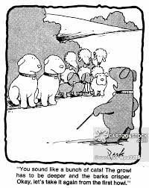
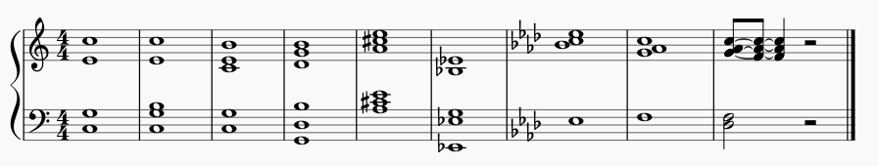
Chord balance in tonal music
Are all pitches equal???
Order of strength (strong to weak)
  Chord root (lower stronger than higher)
  Fifths
  Thirds
  Sevenths
  Other dissonant color pitches

Slide 9
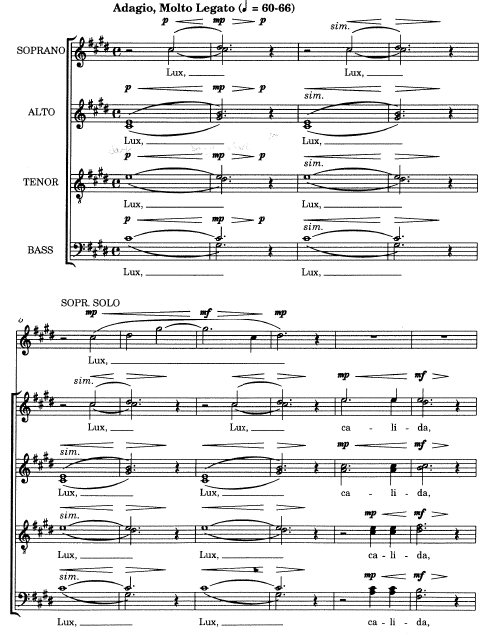
Chord balance sound examples
Lux Light and Sound

Slide 10
Polyphonic balance: fore—mid—back
Polyphonic lines almost never equal
  Foreground: that part most important at the moment
  Middle ground: less important than fore, still important
  Background: supporting parts (harmony, rhythmic motion)

Slide 11
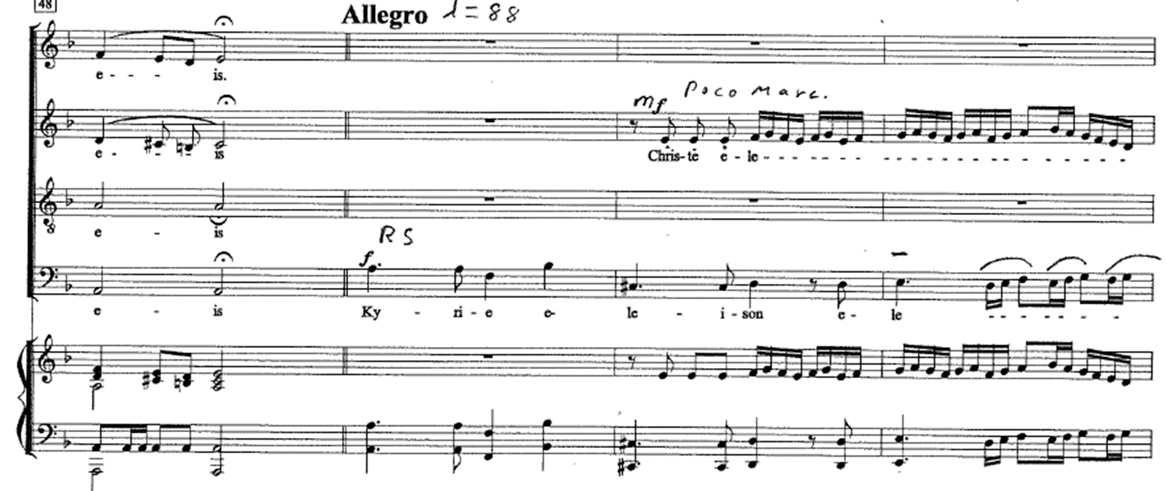
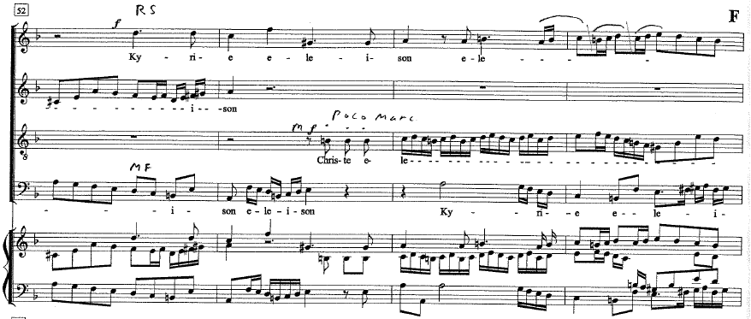
Poly: fore—mid—back

Slide 12

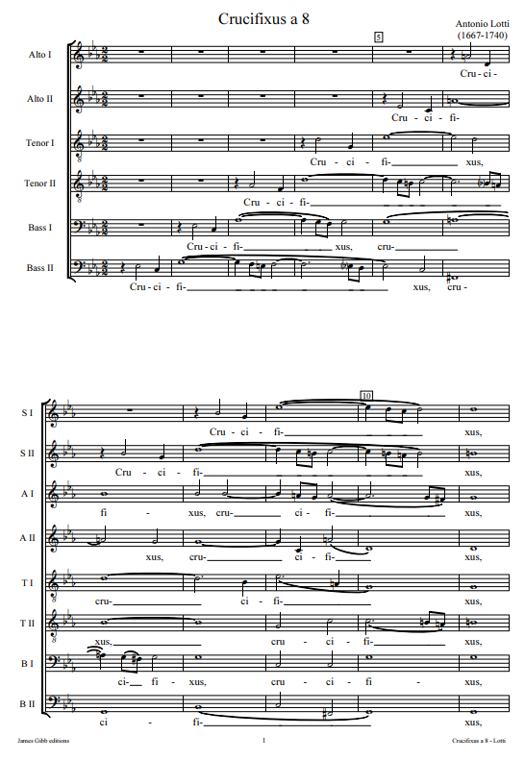
Crescendo—decrescendo
The power of ‘gradual’

Slide 13
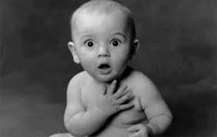
Musical surprises!
Intended by composers for…
  Impact
  Musicality
  Drama
Our job is to…
  find them
  use them to enhance the overall impact
“surprise” challenges expectations (subtle or big)
Notes:
Roughshod over special moments. Whitacre “why don’t they ‘do’ my marks?”
Chord progressions

Slide 14

Case studies: TYFC music excerpts
Guiding questions…
  What is happening in this passage
  What is the composer trying to convey
  What makes this passage special, unique
  What materials/means does the composer use
  How can the performers enhance the meaning,
    and move beyond pitch and rhythm

Slide 15
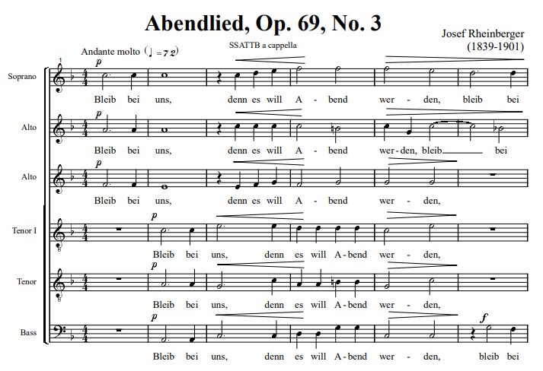

Case studies: TYFC music
Abendlied b.1-6: moving beyond P & R
  What is going on here?
  Chord balance
  Melodic direction
  Harmonic tension

Slide 16
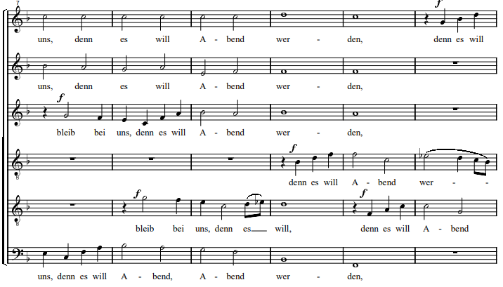



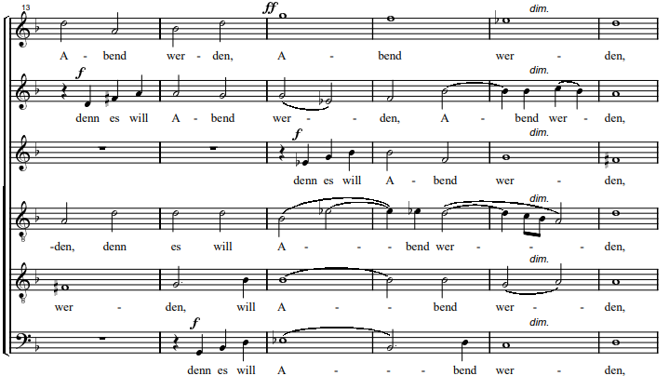
What is going on here?
F-M-B
Melodic shape
  Peak?

Slide 17
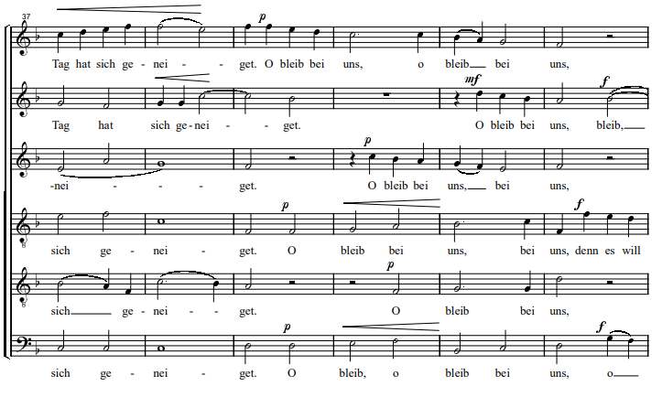

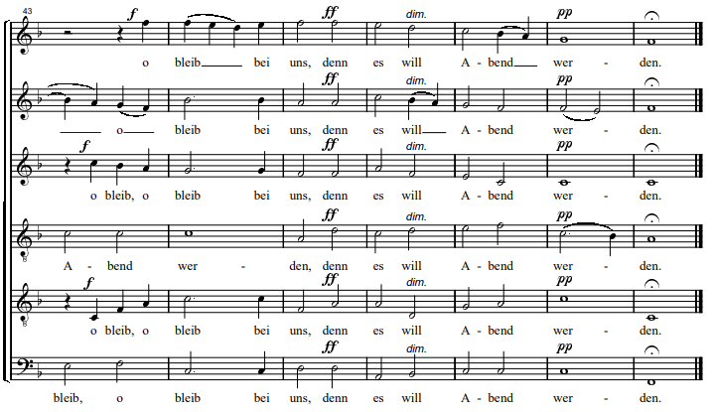
Abendlied b.39-49
What do you see?
Dynamics
F-M-B
Power chord b.45

Slide 18

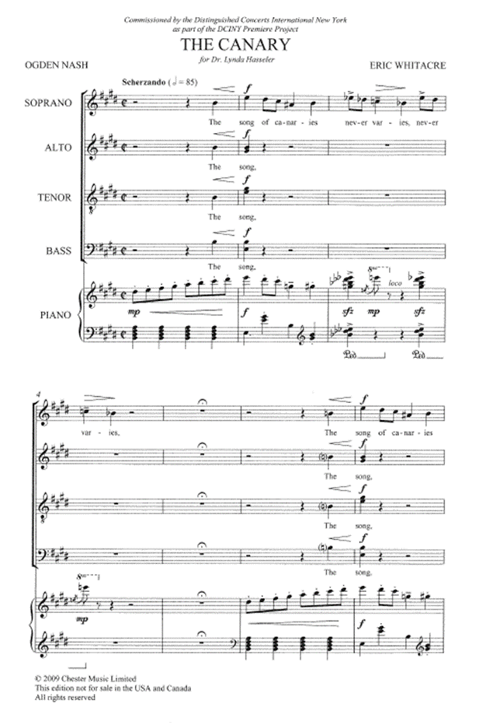


The Canary--Whitacre
What makes this piece work?
  The text!
  “never varies” gesture (x12)
  3-beat pattern in 4/4
    Spaces between?!

Slide 19
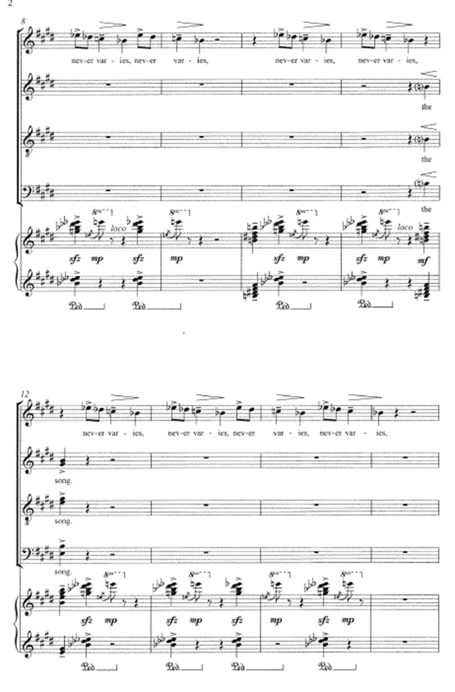

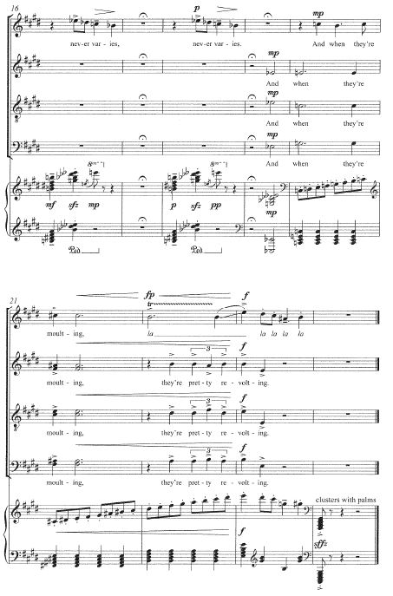


The Canary

Slide 20

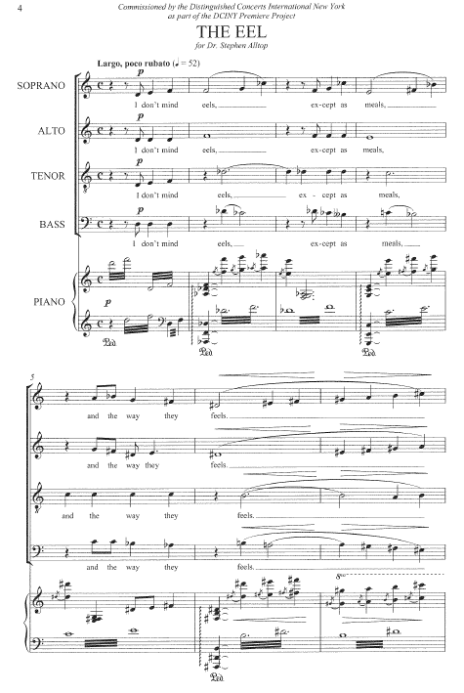
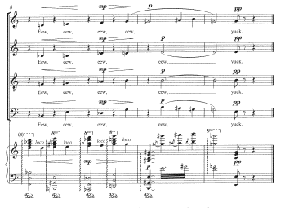
The Eel
Text
Word play:
  “eels” “meals”
  “feels” “Eeew
Melody
  Slithering?
Accompaniment
  Slithering?
Final surprise

Slide 21
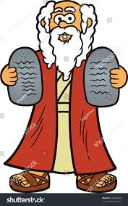
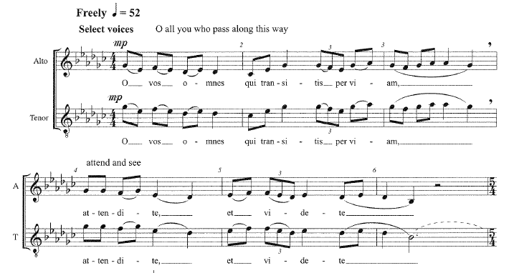
O Vos Omnes (opening)
Meter?
Melodic shape
Style

Slide 22
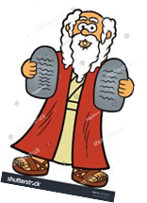
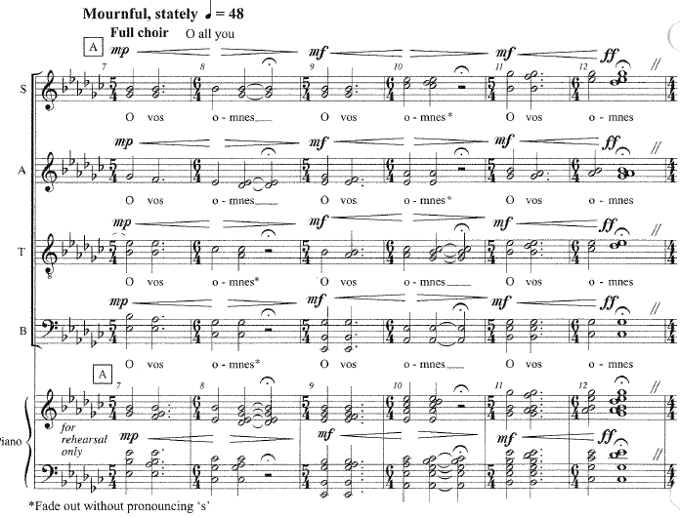
O Vos 7-12
What is going on here?
Chord balance
Dynamics
Text nuance?
Notes:
“Om-nes”

Slide 23

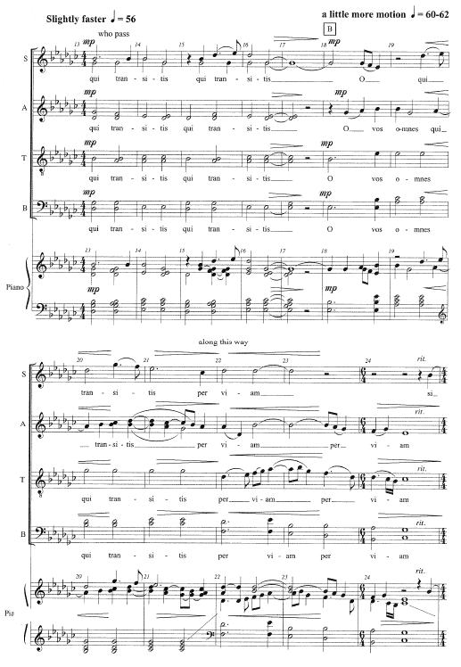

O Vos 13-24
F
F-M-B

Slide 24

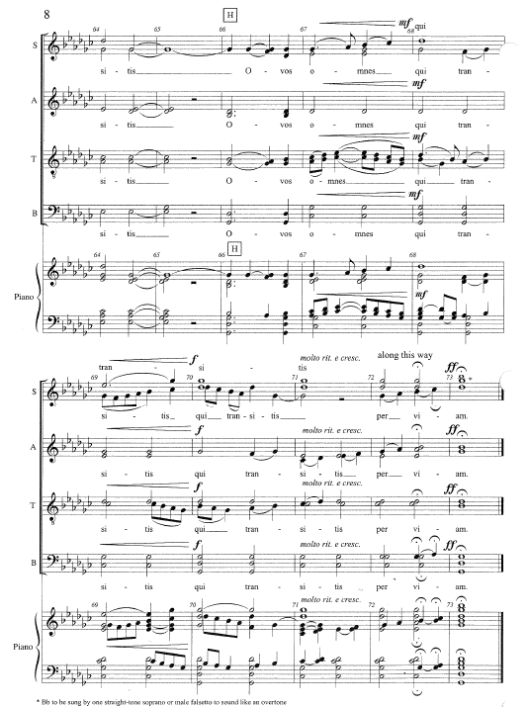


O Vos 66-73
What is happening here?
Dynamics
Melody to end: F-M-B
Notes:
Moving parts = Foreground

Slide 25


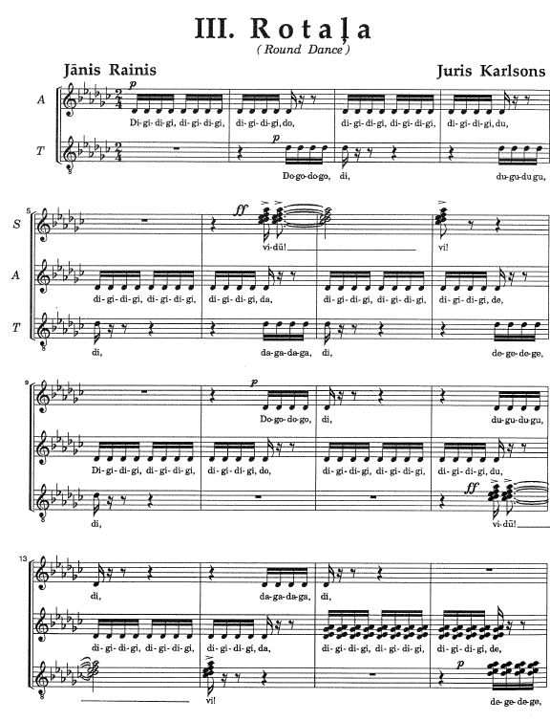
Rotala (round dance)
Overall shape?
Ostinato purpose?
  B.15?
B.6 balance

Slide 26

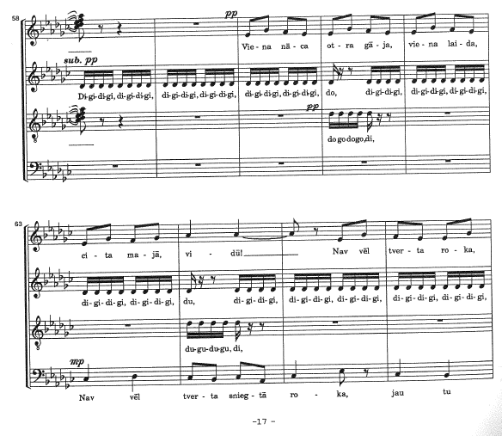

Rotala b.58-66
F-M-B?
  Soprano?
  Or Bass?
Melodic shape?

Slide 27

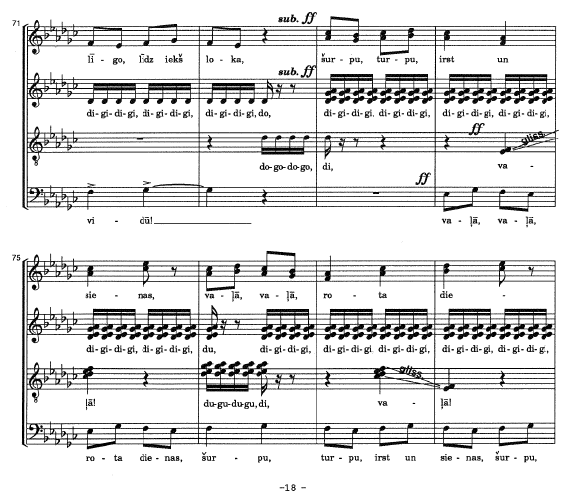

Rotala b.73-78
What is going on?
F-M-B
  Soprano?
  Or Bass?
Chord balance
Melodic shape
High drama!

Slide 28
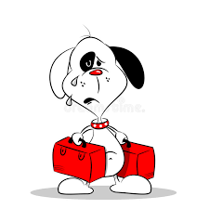
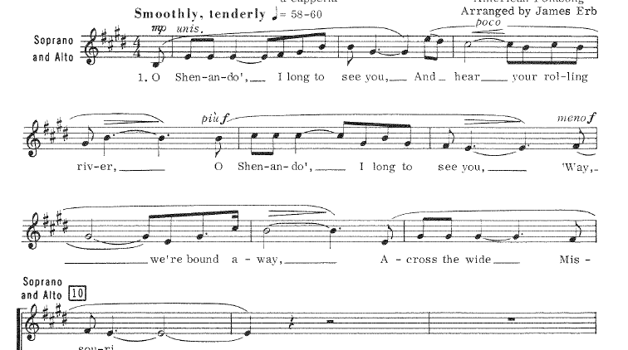
Shenandoah verse one
What is going on?
Melodic shape
Textual expression

Slide 29
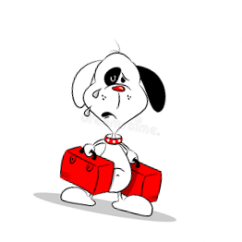
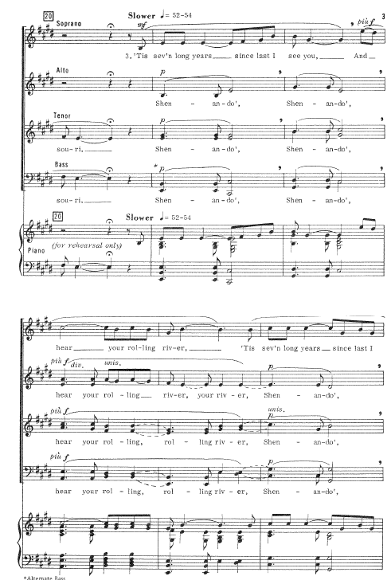
Shenandoah vs 3
F-M-B
Melodic shape
Background shape

Slide 30

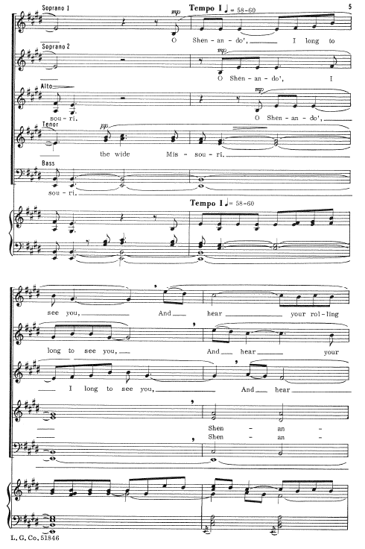


Shenandoah vs 1 reprise
What is going on now?
F-M-B?
  F in canon!
Balance of parts

Slide 31

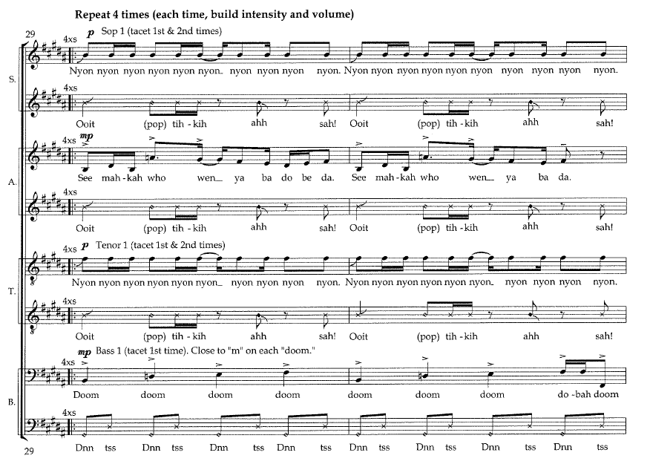
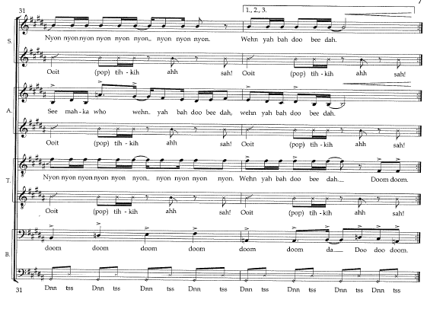
Nyon
1
2
3
What is going on?
  Five separate lines!
F-M-B
How to shape each part
4
5

Slide 32


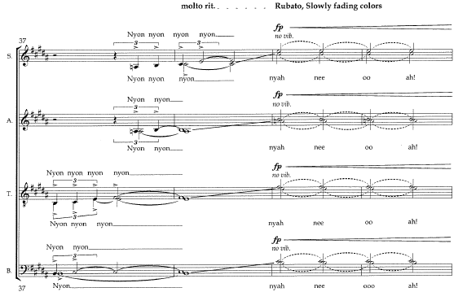

Nyon b.39-40
What is going on here?
Dynamics
Vowel change
“no vibrato”!
Color change

Slide 33
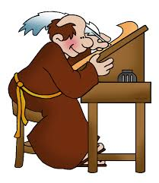
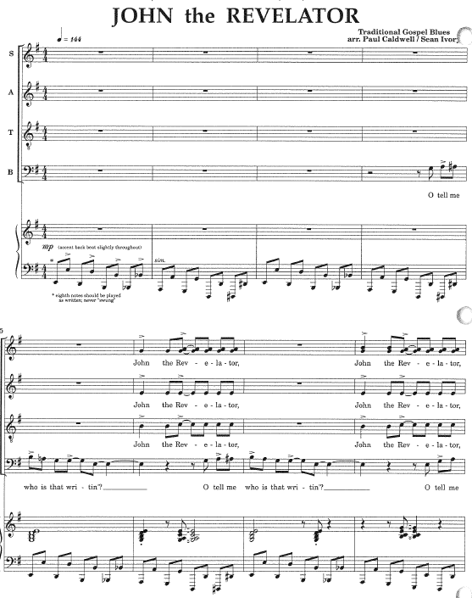
John the Revelator
F-M-B?
Style?
  Articulation marks…
    …literal or suggestive?
  Note lengths…
  …literal or suggestive?

Slide 34
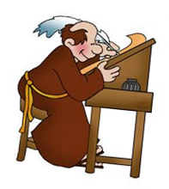




John 17-32
Structure?
  Close refrain
  Begin vs 1
Show closure?
Show dialogue
B.30-32
  Style inform?
  ‘blue’ note?
  Lengths of whole notes
Vs.1
Notes:
Structure: closure of intro, setting up verse one dialogue

Slide 35



John b.45-48
Drama in text: how to enhance
  Crowd demands
  Subtle/suave answer
Question!
The answer!

Slide 36




John b.54-65
What is going on here?
  Chorus is “vamping”
F-M-B?
How to shape?

Slide 37


In summary…
It is our great privilege to…
    …work with other musicians
    …interpret quality music
    …do the hard work of preparation
    …study the parts
    …understand the whole
    …help our musicians ‘get it’
    …enrich the lives of our musicians and audiences

Slide 38



